Slide 1

Week 1 Descriptive Statistics Tutorial
By Prof. Ah-Lian Kor
A.Kor@leedsbeckett.ac.uk

Slide 2
Exam Questions exercises for you to do in your own time
Note: the answers are found in the Week 1 Tutorial Descriptive Statistics Excel Sheets With Answers.xlsx
Watch the video for explanation

Slide 3
Cumulative Frequency Task: Complete the Cumulative Column and Draw a Similar Graph on the Right
Grades | Frequency | Cumulative Frequency
<40 | 4
40 ≤ x < 50 | 6
50 ≤ x < 60 | 8
60 ≤ x < 70 | 15
70 ≤ | 5

Slide 4
Cumulative Percentile Task: Complete the Cumulative Frequency and Percentile Columns and Draw a Similar Graph on the Right
Grades | Frequency | Cumulative Frequency | Cumulative Percentile (%)
<40 | 4
40 ≤ x < 50 | 6
50 ≤ x < 60 | 8
60 ≤ x < 70 | 15
70 ≤ | 5

Slide 5
Measures of Central Tendency (Mode, Median, Mean)
Mode
Find the mode for 5,6,2,3,4,7,8,4,3,6,7
Find the mode for the distribution table below
Interval | Frequency
0 - 39 | 2
40-49 | 34
50-59 | 25
60-69 | 6
70 and above | 7

Slide 6
Range, Mean, Median
Student | Subject 1 | Subject 2 | Subject 3
Student 1 | 60 | 20 | 75
Student 2 | 70 | 100 | 40
Student 3 | 88 | 45 | 100
Student 4 | 67 | 60 | 60
Student 5 | 45 | 45 | 50
Find the following:
Range for Subject 1
Mean for Subject 2
Median for Subject 3

Slide 7
Range, Mean, Median Task: Complete fx (f multiply by x) column and Cumulative Frequency Column. Calculate the mean and median
Score (x) | Frequency (f) | fx | Cumulative Frequency
10 | 100
20 | 300
30 | 200
40 | 50
50 | 30
Grand Total
Find the following:
Mean
Median

Slide 8
Mean for Interval Data Task: Find the mean of the interval data presented in the table below
Time in hours | Frequency
0-4 | 10
5-9 | 5
10-14 | 25
15-19 | 2
20-24 | 30

Slide 9
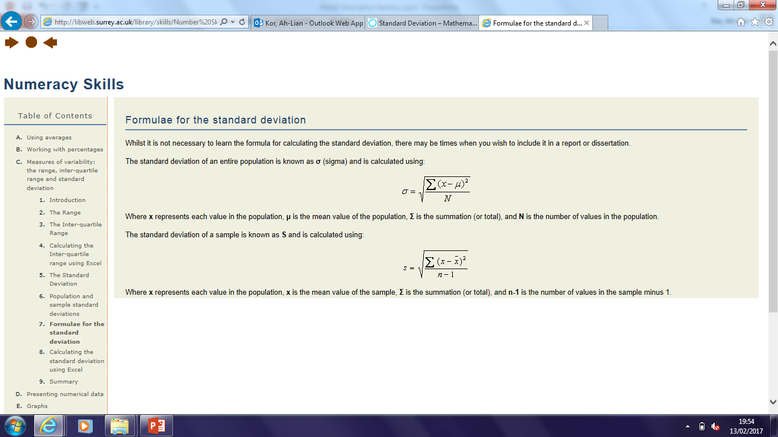
Variance and Standard Deviation

Slide 10
Find the variance and standard deviation for the ungrouped data
X
5
8
2
10

Slide 11
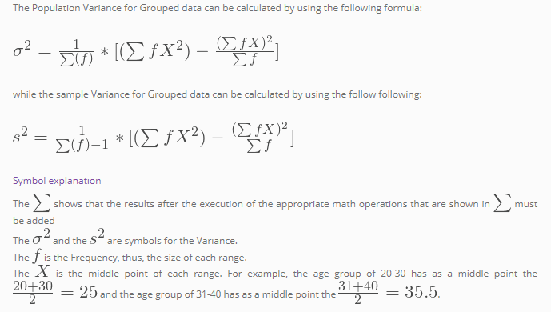
Find variance and standard deviation of grouped sample data
Interval | f
40-44 | 1
45-49 | 7
50-54 | 12
55-59 | 24
60-64 | 29
65-69 | 14
70-74 | 5
75-79 | 3

Slide 12
Work with a Real dataset
Download Week2.xlsx and Wk2Tutorial.xlsx
Upload them into your google drive
Use pandas to read in your file. Note if in google colab, you will have to mount your drive first by typing the following:
from google.colab import drive
drive.mount('/content/gdrive')
Type the following in jupyter notebook:
import pandas as pd
dftrain = pd.read_excel('/content/gdrive/MyDrive/Colab Notebooks/Dataset/Week2.xlsx')
dftrain.head()

Slide 13
Inspect Your Dataset
Type the following:
#Inspect dataset
import pandas as pd
# loading the dataset
data = pd.read_excel('/content/gdrive/MyDrive/Colab Notebooks/Dataset/Week2.xlsx')
# inspecting the data
data.info()

Slide 14
Choose several columns (of interest) in Wk2Tutorial.xlsx
Type the following in a new cell:
#Print only selected columns
import pandas as pd
data = pd.read_excel('/content/gdrive/MyDrive/Colab Notebooks/Dataset/Wk2Tutorial.xlsx')
df = pd.DataFrame(data, columns= ['Age','SAT', 'Grade', 'Height', 'Readership'])
print(df.tail())
print('\n')
print("Print All")
print(df)

Slide 15
Describe selected columns in your dataset
#Describe the selected columns in the dataset
import pandas as pd
data = pd.read_excel('/content/gdrive/MyDrive/Colab Notebooks/Dataset/Wk2Tutorial.xlsx')
df = pd.DataFrame(data, columns= ['Age','SAT', 'Grade', 'Height', 'Readership'])
df.describe()

Slide 16
Skewness in Dataset
#Skewness for selected columns in the dataset
import pandas as pd
data = pd.read_excel('/content/gdrive/MyDrive/Colab Notebooks/Dataset/Wk2Tutorial.xlsx')
df = pd.DataFrame(data, columns= ['Age','SAT', 'Grade', 'Height', 'Readership'])
df.skew(axis = 0, skipna = True)
Notes:
By specifying the column axis (axis=1), the skew() method searches column-wise and returns the skew of each row.
By specifying the column axis (axis=0), the skew() method searches row-wise and returns the skew of each column.
Skipna = True - exclude all null values for computation; axis = 0 is for horizontal and axis = 1 is for column

Slide 17
Kurtosis in Dataset
#Kurtosis for selected columns in the dataset
import pandas as pd
data = pd.read_excel('/content/gdrive/MyDrive/Colab Notebooks/Dataset/Wk2Tutorial.xlsx')
df = pd.DataFrame(data, columns= ['Age','SAT', 'Grade', 'Height', 'Readership'])
df.kurt(axis = 0, skipna = True)
Notes:
By specifying the column axis (axis=1), the kurt() method searches column-wise and returns the kurtosis of each row.
By specifying the column axis (axis=0), the kurt() method searches row-wise and returns the kurtosis of each column.
Skipna = True - exclude all null values for computation; axis = 0 is for horizontal and axis = 1 is for column

Slide 18
Interpretation of Skewness and Kurtosis Values
Refer to lecture notes

Slide 19
Visualisation: Single Scatterplot
Type the following:
#Plot Scatterplot to have a sense of relationships amongst features
#Visualisation for a relationship between Age and Readership (if any)
import pandas as pd
data = pd.read_excel('/content/gdrive/MyDrive/Colab Notebooks/Dataset/Wk2Tutorial.xlsx')
df = pd.DataFrame(data, columns= ['Age', 'Readership'])
df.plot.scatter(x = 'Age', y = 'Readership')

Slide 20
Scatterplot Matrix Plots
Type the following:
#Scatterplot Matrix
import pandas
from pandas.plotting import scatter_matrix
import matplotlib.pyplot as plt
data =pandas.read_excel('/content/gdrive/MyDrive/Colab Notebooks/Dataset/Wk2Tutorial.xlsx')
df =pandas.DataFrame(data, columns= ['Age','SAT', 'Grade', 'Height', 'Readership'])
pandas.plotting.scatter_matrix(df, figsize =(10,10))
plt.show()

Slide 21
Action Points
Action Point 1
Complete all the SPT (Weeks 1 and 2)
Action Point 2
Have chosen a dataset
Aim and Objectives
Conduct Level 1 Descriptive Statistics for Report
Populate DAV Assignment Report

